Slide 1


Fabian Hueske
Flink Forward
Sep 12, 2016
Taking a look under the hood of Apache Flink’s® relational APIs

Slide 2

DataStream API is not for Everyone
Writing DataStream programs is not easy
Requires Knowledge & Skill
Stream processing concepts (time, state, windows, triggers, ...)
Programming experience (Java / Scala)
Program logic goes into UDFs
great for expressiveness
bad for optimization - need for manual tuning
https://www.flickr.com/photos/scottvanderchijs/3630946389, CC BY 2.0

Slide 3
What are relational APIs?
Relational APIs are declarative
User says what is needed.
System decides how to compute it.
Users do not specify implementation.
Queries are efficiently executed!

Slide 4
Agenda
Relational Queries for streaming and batch data
Flink’s Relational APIs
Query Translation Step-by-Step
Current State & Outlook

Slide 5
Relational Queries for Streaming and Batch Data

Slide 6
Flink = Streaming and Batch
Flink is a platform for distributed stream and batch data processing
Relational APIs for streaming and batch tables
Queries on batch tables terminate and produce a finite result
Queries on streaming tables run continuously and produce result stream
Same syntax & semantics for streaming and batch queries

Slide 7
Streaming Queries
Implementing streaming applications is challenging
Only some people have the skills
Stream processing technology spreads rapidly
There is a talent gap
Lack of OS systems that support SQL on parallel streams
Relational APIs will make this technology more accessible

Slide 8
Streaming Queries
Consistent results require event-time processing
Results must only depend on input data
Not all relational operators can be naively applied on streams
Aggregations, joins, and set operators require windows
Sorting is restricted
We can make it work with some extensions & restrictions!

Slide 9
Batch Queries
Relational queries on batch tables?
Are you kidding? Yet another SQL-on-Hadoop solution?
Easing application development is primary goal
Simple things should be simple
Built-in (SQL) functions supersede UDFs
Better integration of data sources
Not intended to compete with dedicated SQL engines

Slide 10
Flink’s Relational APIs

Slide 11
Relational APIs in Flink
Flink features two relational APIs
Table API (since Flink 0.9.0)
SQL (since Flink 1.1.0)
Equivalent feature set (at the moment)
Table API and SQL can be mixed
Both are tightly integrated with Flink’s core APIs
DataStream
DataSet

Slide 12
Table API
Language INtegrated Query (LINQ) API
Queries are not embedded as String
Centered around Table objects
Operations are applied on Tables and return a Table
Available in Java and Scala

Slide 13
Table API Example (streaming)
val sensorData: DataStream[(String, Long, Double)] = ???
// convert DataSet into Table
val sensorTable: Table = sensorData
.toTable(tableEnv, 'location, ’time, 'tempF)
// define query on Table
val avgTempCTable: Table = sensorTable
.groupBy('location)
.window(Tumble over 1.days on 'rowtime as 'w)
.select('w.start as 'day, 'location, (('tempF.avg - 32) * 0.556) as 'avgTempC) .where('location like "room%")

Slide 14
SQL
Standard SQL
Queries are embedded as Strings into programs
Referenced tables must be registered
Queries return a Table object
Integration with Table API

Slide 15
SQL Example (batch)
// define & register external Table
val sensorTable: new CsvTableSource( "/path/to/data", Array("location", "day", "tempF"), // column names Array(String, String, Double)) // column types
tableEnv.registerTableSource("sensorData", sensorTable)
// query registered Table
val avgTempCTable: Table = tableEnv
.sql("""
SELECT day, location, AVG((tempF - 32) * 0.556) AS avgTempC
FROM sensorData
WHERE location LIKE 'room%'
GROUP BY day, location""")

Slide 16
Query Translation Step-by-Step

Slide 17
2 APIs [SQL, Table API]
*
2 backends [DataStream, DataSet]
=
4 different translation paths?

Slide 18
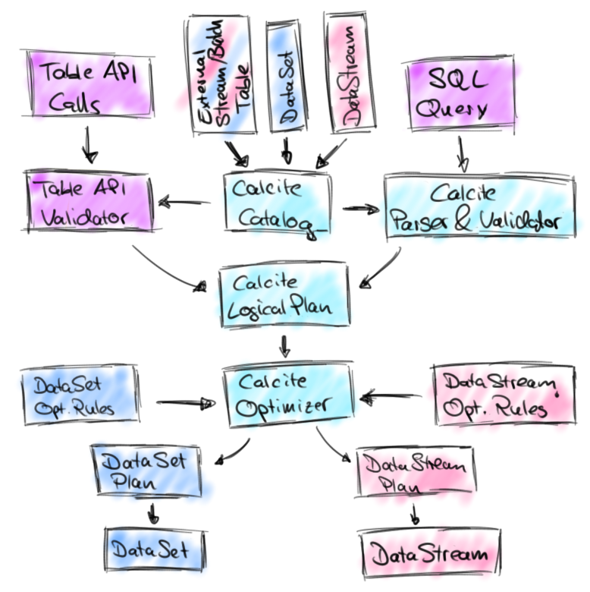
Nope!

Slide 19
What is Apache Calcite® ?
Apache Calcite is a SQL parsing and query optimizer framework
Used by many other projects to parse and optimize SQL queries
Apache Drill, Apache Hive, Apache Kylin, Cascading, …
… and so does Flink
The Calcite community put Streaming SQL on their agenda
Extension to standard SQL
Committer Julian Hyde gave a talk about Streaming SQL this morning

Slide 20
Architecture Overview
Table API and SQL queries are translated into common logical plan representation.
Logical plans are translated and optimized depending on execution backend.
Plans are transformed into DataSet or DataStream programs.

Slide 21
Catalog
Table definitions required for parsing, validation, and optimization of queries
Tables, columns, and data types
Tables are registered in Calcite’s catalog
Tables can be created from
DataSets
DataStreams
TableSources (without going through DataSet/DataStream API)

Slide 22
Table API to Logical Plan
API calls are translated into logical operators and immediately validated
API operators compose a tree
Before optimization, the API operator tree is translated into a logical Calcite plan

Slide 23
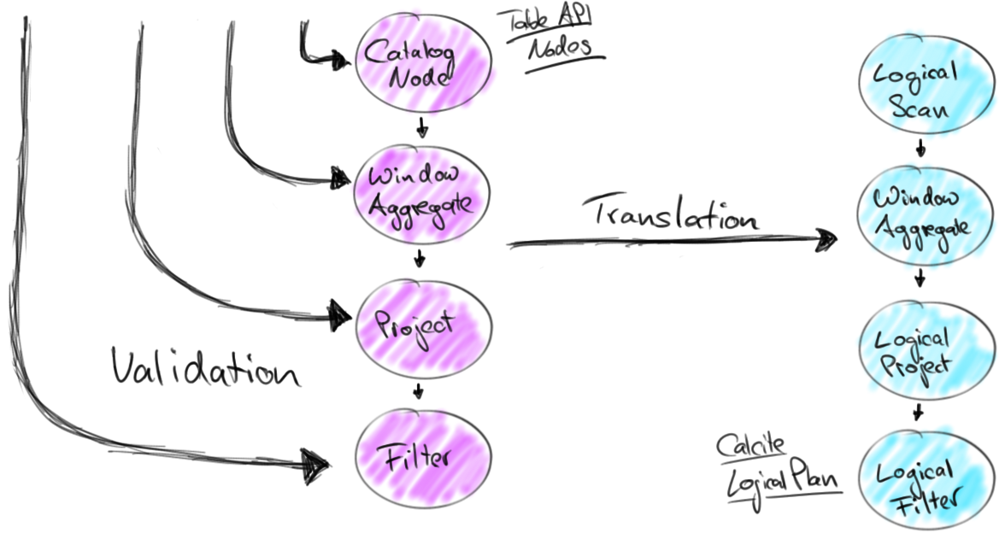
Table API to Logical Plan
sensorTable
.groupBy('location)
.window(Tumble over 1.days on 'rowtime as 'w)
.select('w.start as 'day, 'location, (('tempF.avg - 32) * 0.556) as 'avgTempC) .where('location like "room%")

Slide 24
SQL Query to Logical Plan
Calcite parses and validates SQL queries
Table & attribute names
Input and return types of expressions
…
Calcite translates parse tree into logical plan
Same representation as for Table API queries

Slide 25
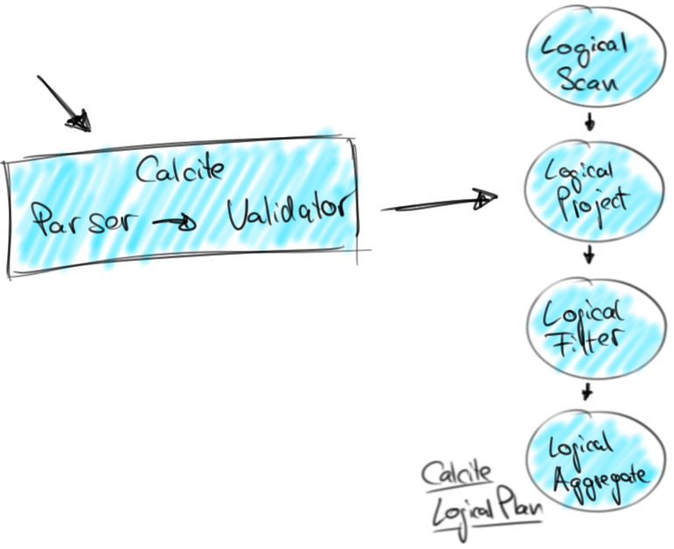
SQL Query to Logical Plan
SELECT day, location,
AVG((tempF - 32) * 0.556) AS avgTempC
FROM sensorData
WHERE location LIKE 'room%’
GROUP BY day, location

Slide 26
Query Optimization
Calcite features a Volcano-style optimizer
Rule-based plan transformations
Cost-based plan choices
Calcite provides many optimization rules
Custom rules to transform logical nodes into Flink nodes
DataSet rules to translate batch queries
DataStream rules to translate streaming queries

Slide 27
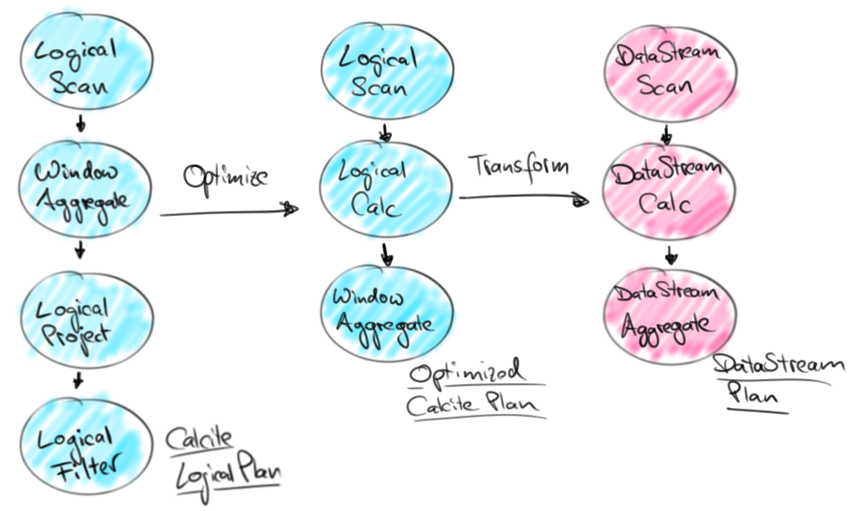
Query Optimization

Slide 28
Flink Plan to Flink Program
Flink nodes translate themselves into DataStream or DataSet operators
User functions are code generated
Expressions, conditions, built-in functions, …
Code is generated as String
Shipped in user-function and compiled at worker
Janino Compiler Framework
Batch and streaming queries share code generation logic

Slide 29
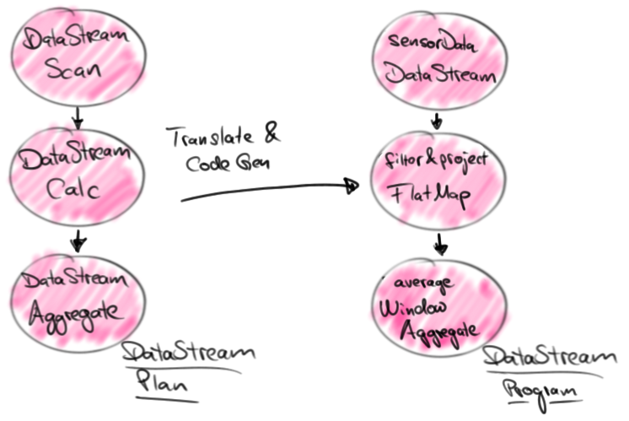
Flink Plan to Flink Program

Slide 30
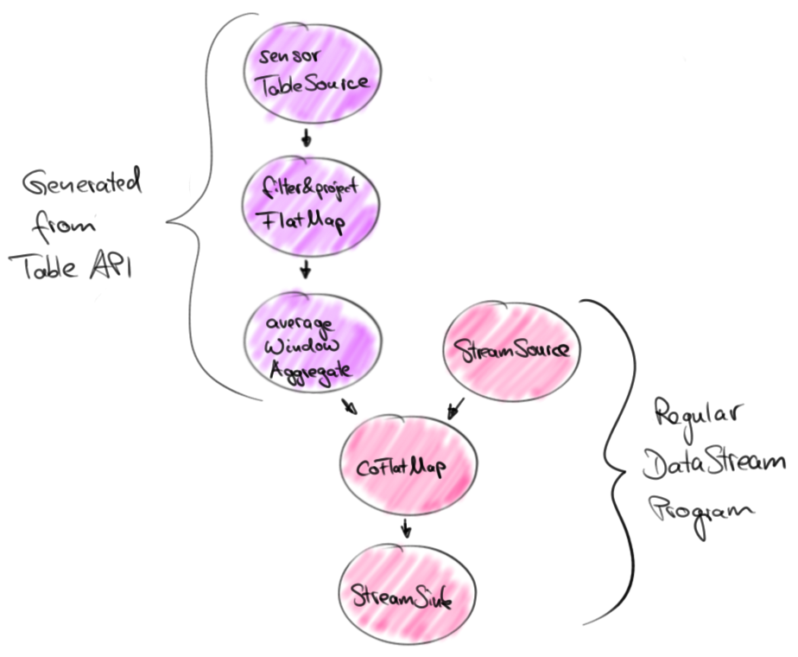
Execution
Generated operators are embedded in DataStream or DataSet programs.
DataSet programs are also optimized by Flink’s DataSet optimizer
Holistic execution

Slide 31
Current State & Outlook

Slide 32
Current State
Flink 1.1 features Table API & SQL on Calcite
Streaming SQL & Table API support
Selection, Projection, Union
Batch SQL & Table API support
Selection, Projection, Sort
Inner & Outer Equi-Joins, Set operations

Slide 33
Outlook: Streaming Table API & SQL
Streaming Aggregates
Table API (aiming for Flink 1.2)
Streaming SQL (Calcite community is working on this)
Joins
Windowed Stream - Stream Joins
[Static Table, Slow Stream] – Stream Joins
More TableSource and Sinks

Slide 34
General Improvements
Extend Code Generation
Optimized data types
Specialized serializers and comparators
Aggregation functions
More SQL functions and support for UDFs
Stand-alone SQL client

Slide 35
Contributions welcome
There is still a lot to do
New operators and features
Performance improvements
Tooling and integration
Get in touch and start contributing!

Slide 36
Summary
Relational APIs for streaming and batch data
Language-integrated Table API
Standard SQL (for batch and stream tables)
Joint optimization (Calcite) and code generation
Execution as DataStream or DataSet programs
Stream analytics for everyone!

